Slide 1
Realization of WP6 activities
Milan Gocić
University of Niš
15 September2020
This project has been funded with support from the European Commission. This publication reflects the views only of the author, and the Commission cannot be held responsible for any use which may be made of the information contained therein.

Slide 2
A6.2 Development of project website and promotional materials
Organisation of promotional events (workshops, conferences, seminars) and prepare dissemination form
If it is possible organised TV or radio interview or prepare material for on-line or printed media
Strengthening of master curricula in water resources management
for the Western Balkans HEIs and stakeholders
www.swarm.ni.ac.rs

Slide 3
Leaflet with mid-term resultssector
Strengthening of master curricula in water resources management
for the Western Balkans HEIs and stakeholders
www.swarm.ni.ac.rs

Slide 4
Leaflet with mid-term resultssector
Strengthening of master curricula in water resources management
for the Western Balkans HEIs and stakeholders
www.swarm.ni.ac.rs

Slide 5
A6.3 Info days for student enrolment
Promotion for student enrollemtn should be organised (one per WB HEI)
Material: photos and dissemination form
Strengthening of master curricula in water resources management
for the Western Balkans HEIs and stakeholders
www.swarm.ni.ac.rs

Slide 6
Leaflet - TCASUsector
Strengthening of master curricula in water resources management
for the Western Balkans HEIs and stakeholders
www.swarm.ni.ac.rs

Slide 7
Leaflet - TCASUsector
Strengthening of master curricula in water resources management
for the Western Balkans HEIs and stakeholders
www.swarm.ni.ac.rs

Slide 8
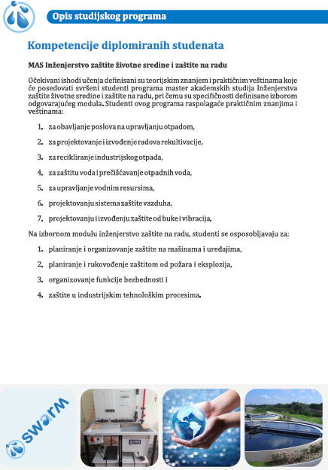
Brochure - UPKMsector
Strengthening of master curricula in water resources management
for the Western Balkans HEIs and stakeholders
www.swarm.ni.ac.rs

Slide 9
A6.4 Roundtables with non-academic sector
One roundtable should be organised by 14 November 2020
Number of participants > 15
Documentation: agenda, photos, list of attendees, event report and dissemination form
Strengthening of master curricula in water resources management
for the Western Balkans HEIs and stakeholders
www.swarm.ni.ac.rs

Slide 10
Leaflet for training promotion in Englishsector
Strengthening of master curricula in water resources management
for the Western Balkans HEIs and stakeholders
www.swarm.ni.ac.rs

Slide 11
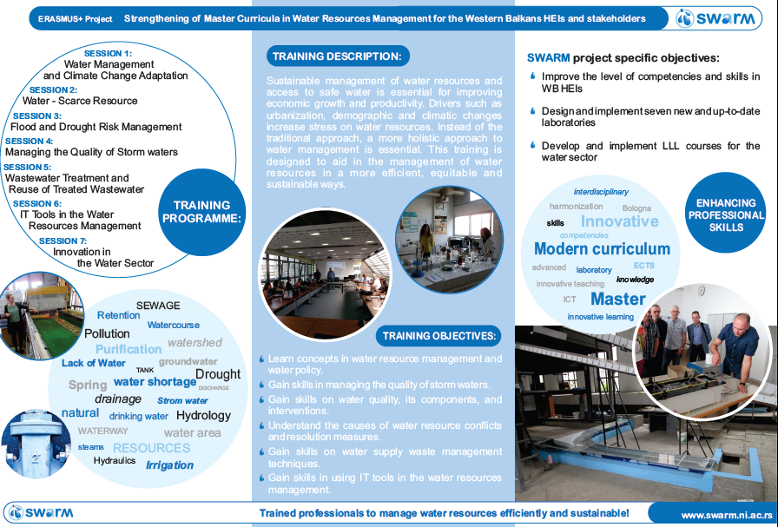
Leaflet for training promotion in Englishsector
Strengthening of master curricula in water resources management
for the Western Balkans HEIs and stakeholders
www.swarm.ni.ac.rs

Slide 12
Leaflet for training promotion in Serbiansector
Strengthening of master curricula in water resources management
for the Western Balkans HEIs and stakeholders
www.swarm.ni.ac.rs

Slide 13
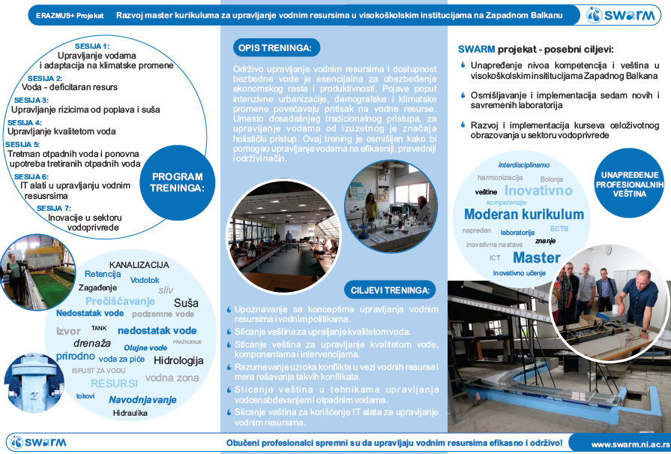
Leaflet for training promotion in Serbiansector
Strengthening of master curricula in water resources management
for the Western Balkans HEIs and stakeholders
www.swarm.ni.ac.rs

Slide 14
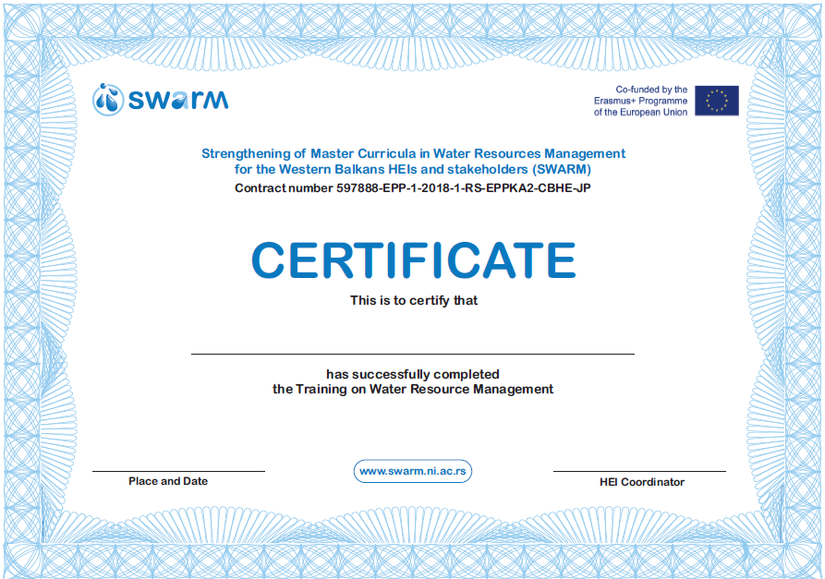
Certificatesector
Strengthening of master curricula in water resources management
for the Western Balkans HEIs and stakeholders
www.swarm.ni.ac.rs

Slide 15
A6.5 Winter/summer schools sector
Minimum 6 students per school
Duration: 12 days + 2 days for travelling. After each realised event the dissemination form should be created. Events should be evaluated and report written.
Programme partner HEIs should prepare agenda.
Strengthening of master curricula in water resources management
for the Western Balkans HEIs and stakeholders
www.swarm.ni.ac.rs

Slide 16
A6.5 Winter/summer schools sector
Training of teaching staff: BOKU - UNMO (1), TCASU (1), UoM (1); UACEG – UNI (2), UPKM (1); UL – UNS (1), UNSA (1), UoM (1); AUTh – UNI (2), UNSA (1); UNIRIFCE – UNI (2), UPKM (1); NMBU – UNS (1), UNMO (1)
Duration: 5 days + 2 days for travelling. After each realised event the dissemination form should be created. Events should be evaluated and report written.
Programme partner HEIs should prepare agenda.
Strengthening of master curricula in water resources management
for the Western Balkans HEIs and stakeholders
www.swarm.ni.ac.rs

Slide 17
A6.6 Symposium for promoting WRM in WB sector
Organizer UNS, July 2021 (two days)
Each of participants (24) should present results obtained during the SWARM realisation. It will be nice to present student papers realised using new equipment at WB HEIs.
UNS should print: max. 200x proceedings for symposium, 150x agendas and ID cards for symposium
Participants: as more as possible + media
Strengthening of master curricula in water resources management
for the Western Balkans HEIs and stakeholders
www.swarm.ni.ac.rs

